Slide 1
Practical Task : Job Shop Scheduling Problem
Guzel Khuziakhmetova, Deeksha Makholiya
International Center for Computational Logic Technische Universität Dresden, Germany
What is a solution?
Evaluation Function?
Representation of solution?
Constraints?
Analysis Method of Feasibility.
08.07.2019

Slide 2
Defining Jobs and Variable
Let task(i, j) denote the jth task in the sequence for job i
job 1 = [(0,4) (1,3) (2,5)]
job 2 = [(2,4) (1,3) (0,4)]
job 3 = [(0,6) (2,3) (1,3)]
Define t_{i, j} to be the start time for task(i, j). The t_{i, j} are the variables in the job shop problem
Variable :
task (1,1) = [0,4] task (2,1)=[2,4] task (3,1)=[0,6]
task (1,2) = [1,3] task (2,2)=[1,3] task (3,2)=[0,6]
task (1,1) = [0,4] task (2,1)=[0,4] task (3,3)=[1,3]
Machine Task:
M0 = (0,4) (0,4) (0,6)
M1 = (1,3) (1,3) (1,3)
M2 = (2,5) (2,4) (2,3)
Practical Task : Job Shop Scheduling Problem

Slide 3
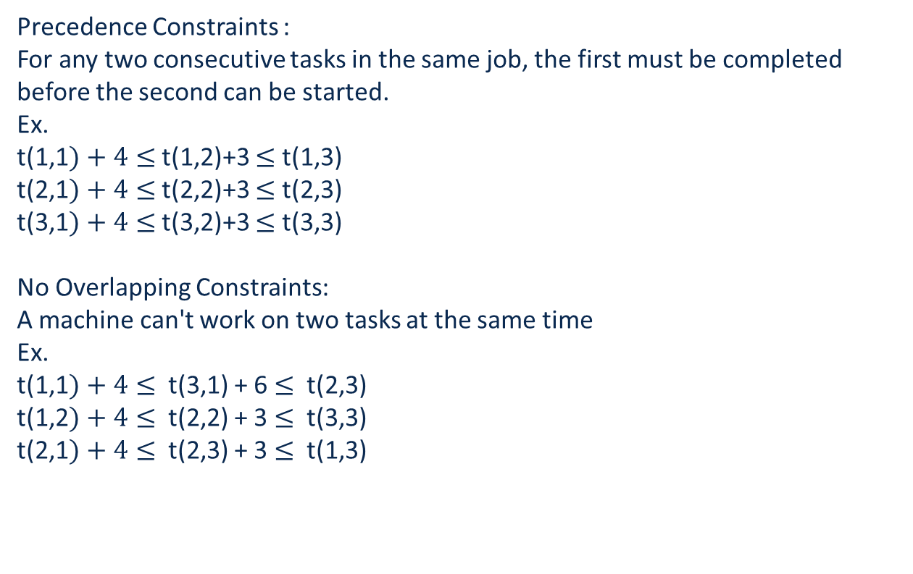
Defining Constraints:
Precedence Constraints :
For any two consecutive tasks in the same job, the first must be completed before the second can be started.
Ex.
t(1,1$)+4≤$ t(1,2)+3 $≤$ t(1,3)
t(2,1$)+4≤$ t(2,2)+3 $≤$ t(2,3)
t(3,1$)+4≤$ t(3,2)+3 $≤$ t(3,3)
No Overlapping Constraints:
A machine can't work on two tasks at the same time
Ex.
t(1,1$)+4≤$ t(3,1) + 6 $≤$ t(2,3)
t(1,2$)+4≤$ t(2,2) + 3 $≤$ t(3,3)
t(2,1$)+4≤$ t(2,3) + 3 $≤$ t(1,3)
Practical Task : Job Shop Scheduling Problem

Slide 4
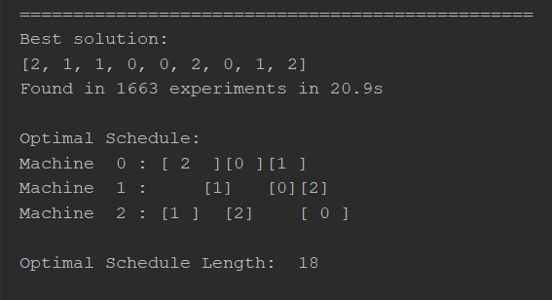
Representation of solution?
Sorting the problem according to the machine (constraints provided) in the table.
Example:
Practical Task : Job Shop Scheduling Problem

Slide 5
What is the solution?
A solution to the job shop problem is an assignment of a start time for each task, which meets the constraints given
Evaluation Function?
Makespan: the length of time from earliest start time of the jobs to the latest end time
We want to minimize the length of the schedule (makespan)
Practical Task : Job Shop Scheduling Problem

Slide 6
Algorithm Used:
Simulated Annealing:
Step1. Get an initial solution S
Step2. Set an initial temperature, T> 0.
Step3. While not frozen do the following:
Step3.1 . Do the following L times:
Step3.1.1. Sample a neighbour S’ from S.
Step3.1.2. Let delta = cost (S’) – cost(S) .
Step3.1.3. If delta=0
then ( i.e . Down hill move) set S =S’
else ( i.e . uphill move )
set S =S’ with the probability of exp(-delta/T) .
Step3.2. Set T = r x T, where r is the reduction factor.
Step4. Return S
Practical Task : Job Shop Scheduling Problem

